Slide 1

Health & Space
Metropolitan Data 1 October 2022
AMSTERDAM
By Annika, Pelle, Sam & Marta

Slide 2
Contents
Exploration
Analysis
Interpretation
Implication
Conclusion
Introduction

Slide 3
Introduction
Notes:
Insert a map with districts?

Slide 4
Objective
Understanding the current relationships between greenery, living environment aesthetics and health in Amsterdam.
Providing insights for policy innovation and implementation in Amsterdam.
What is the relationship between the population’s health, greenery and living environment aesthetics of Amsterdam?
What is the correlation between public spaces and self-perceived good health, psychological health issues, loneliness and obesity per district?
What other variables could influence the relationship of the space to the state of health?
Notes:
It is often said that health and wellbeing can be facilitated by the environments where people live . Discovering whether this statement applies in the selected city could cater to the improvement of both health of the citizens and quality of the public space. The aim is to inform the governing bodies of the city about the current situation regarding these topics and support policy development, innovation, and implementation. Source is needed
Yes, down below a couple of times as well, think can be copied from the file that Pelle and Annika wrote last week

Slide 5
Dataset Selection
Health
Hea_lonely (int)
Hea_overweight (int)
Public Space
Pub_area_land (int)
Pub_area_water (int)
Population
Pop_60_69 (int)
Pop_70_79 (int)
Housing
Income
Social
Hea_good (int)
Hea_psy (int)
Hou_value (int)
Inc_disposable (int)
Soc_fac_cultural (int)
Soc_fac_sports (int)
Pub_area_green (int)
Pub_setup (chr)
Pub_green (chr)
Pop_80_89 (int)
Pop_90 (int)
Pop_total (int)
Notes:
List the used variables, and explain what type they are Explain that we used inner_join
Mention that we created some variables through the mutate function to make calculations easier

Slide 6
Summary data sets
Population | Avg_health | Avg_greenery | Avg_income | Tot_social_facilities | Avg_hou_value
615 699 | 72,5 | 0,085 | 42 040. | 4561 | 377 605.
District | Population | Avg_health | Avg_greenery | Avg_income | Tot_social_facilities | Avg_hou_value
Nieuw-west | 140 433 | 68,2 | 0,104 | 38487. | 481 | 296814.
Oost | 114 805 | 76,2 | 0,037 | 49242. | 1023 | 466806.
West | 106 015 | 75,4 | 0,036 | 40803. | 1406 | 404409.
Zuidoost | 75 824 | 67,4 | 0,165 | 34037. | 204 | 219700.
Zuid | 73 624 | 77,4 | 0,061 | 48644. | 670 | 528393.
Noord | 73 412 | 68,7 | 0,142 | 38414. | 322 | 306975.
Centrum | 31 586 | 77,7 | 0,053 | 50151. | 455 | 532295.

Slide 7
Exploration

Slide 8
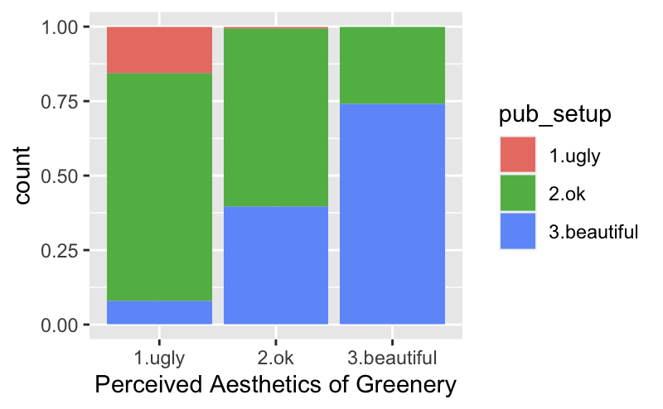
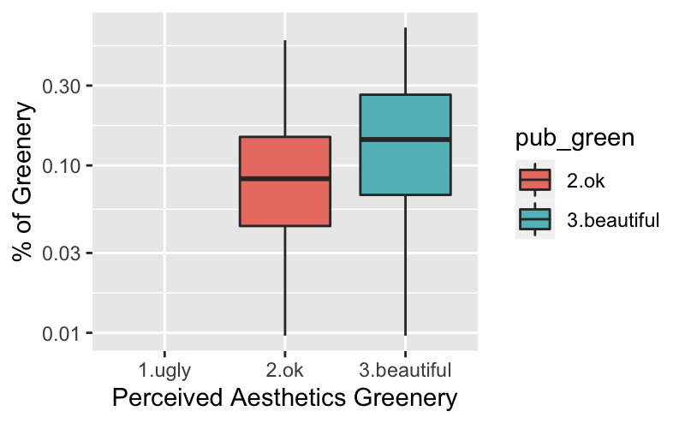
Greenery & Aesthetics Amsterdam
More beautiful greenery tends to lead to more beautiful perceived aesthetics of the local environment.
Regions with higher percentage of relative greenery tend to be perceived as more beautiful
Scale transformed to show difference better
'Ugly' level had boxplot at 0.0
Notes:
There is no boxplot for “ugly” because there are only “ugly” data points with no percentages of greenery
The scale had to be transformed to avoid a messy graph.

Slide 9
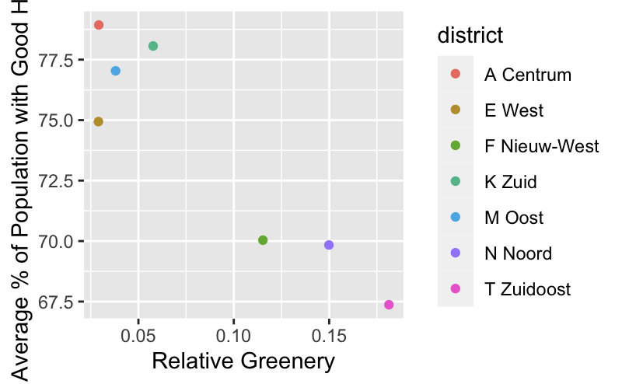
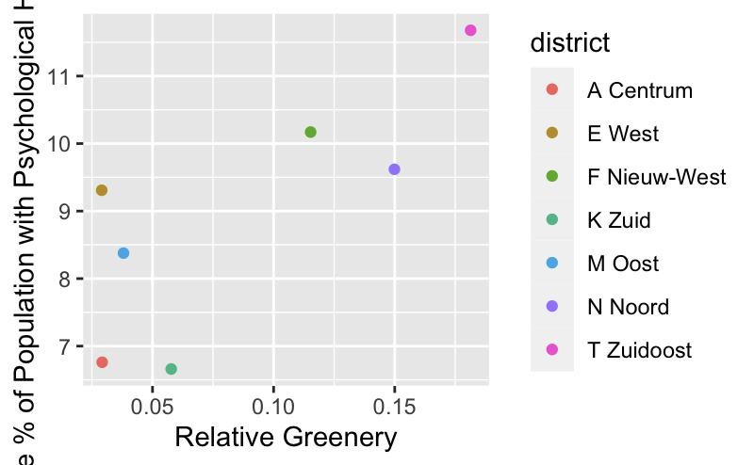
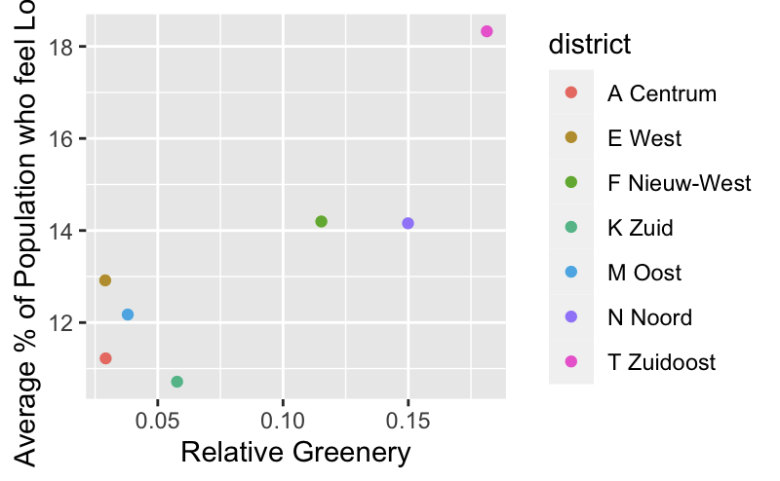
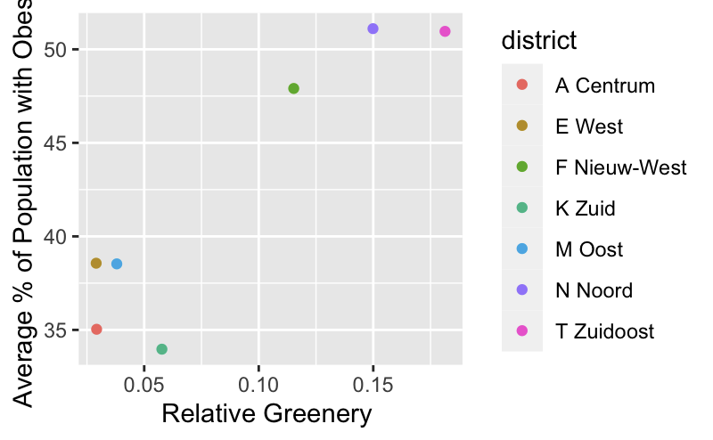
Health & Greenery
Plotting averages for districts showed counterintuitive results
Does more greenery lead to worse health?
Does greenery worsen psychological health, loneliness and obesity?
Notes:
*Know that the poorest districts (by income) are Zuidoost, Noord, and Nieuw-West, so here the health in those is probably defined by the fact that those districts are poor and not by the fact that there is a lot of greenery…

Slide 10
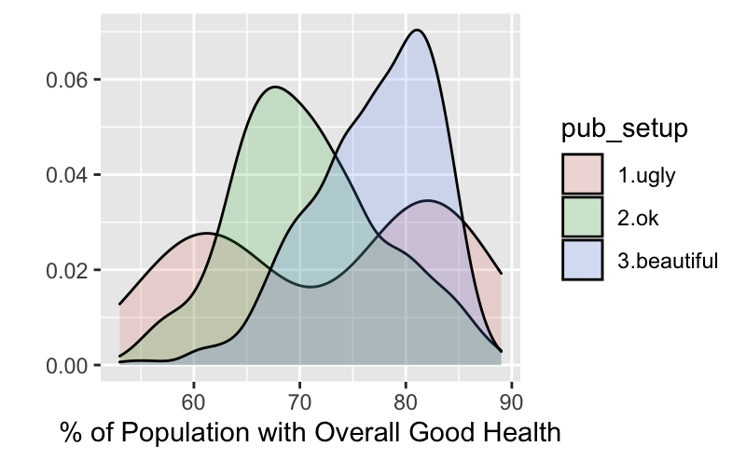
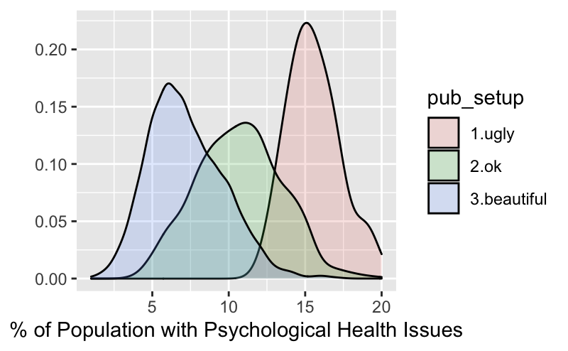
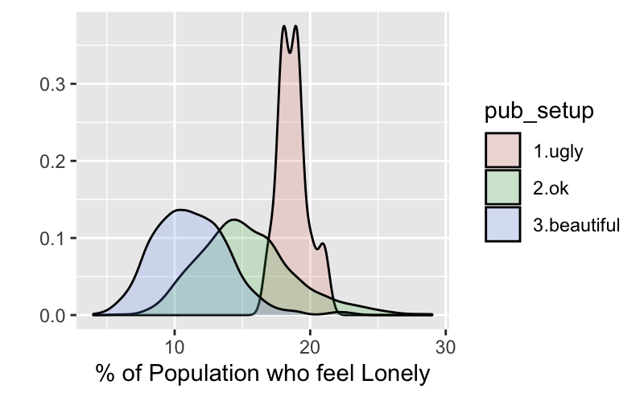
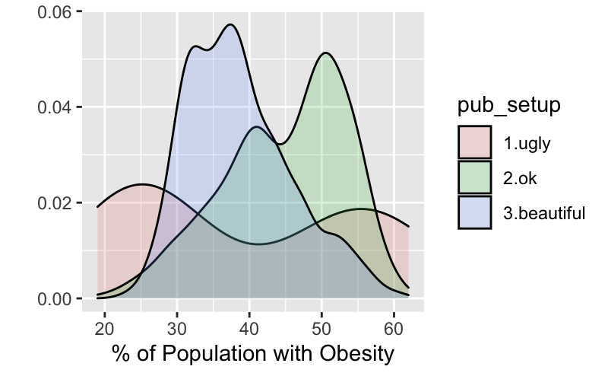
Health & Perceived Quality of the Living Environment
No significant relationship between overall health and perceived aesthetics of the living environment.
Relationship between loneliness and psychological health and perceived aesthetics of the living environment
Both ways?
Notes:
Generally, on the previous slide the amount of greenery per district did not drive the health levels. Here a correlation between perceived quality of the environment and different aspects of health can be seen.
A difficult question we could get here is:
is it that the population who is depressed (poor mental health) tends to assess their surroundings as poor because they are ill or is it really that the environment has the playing role in this?

Slide 11
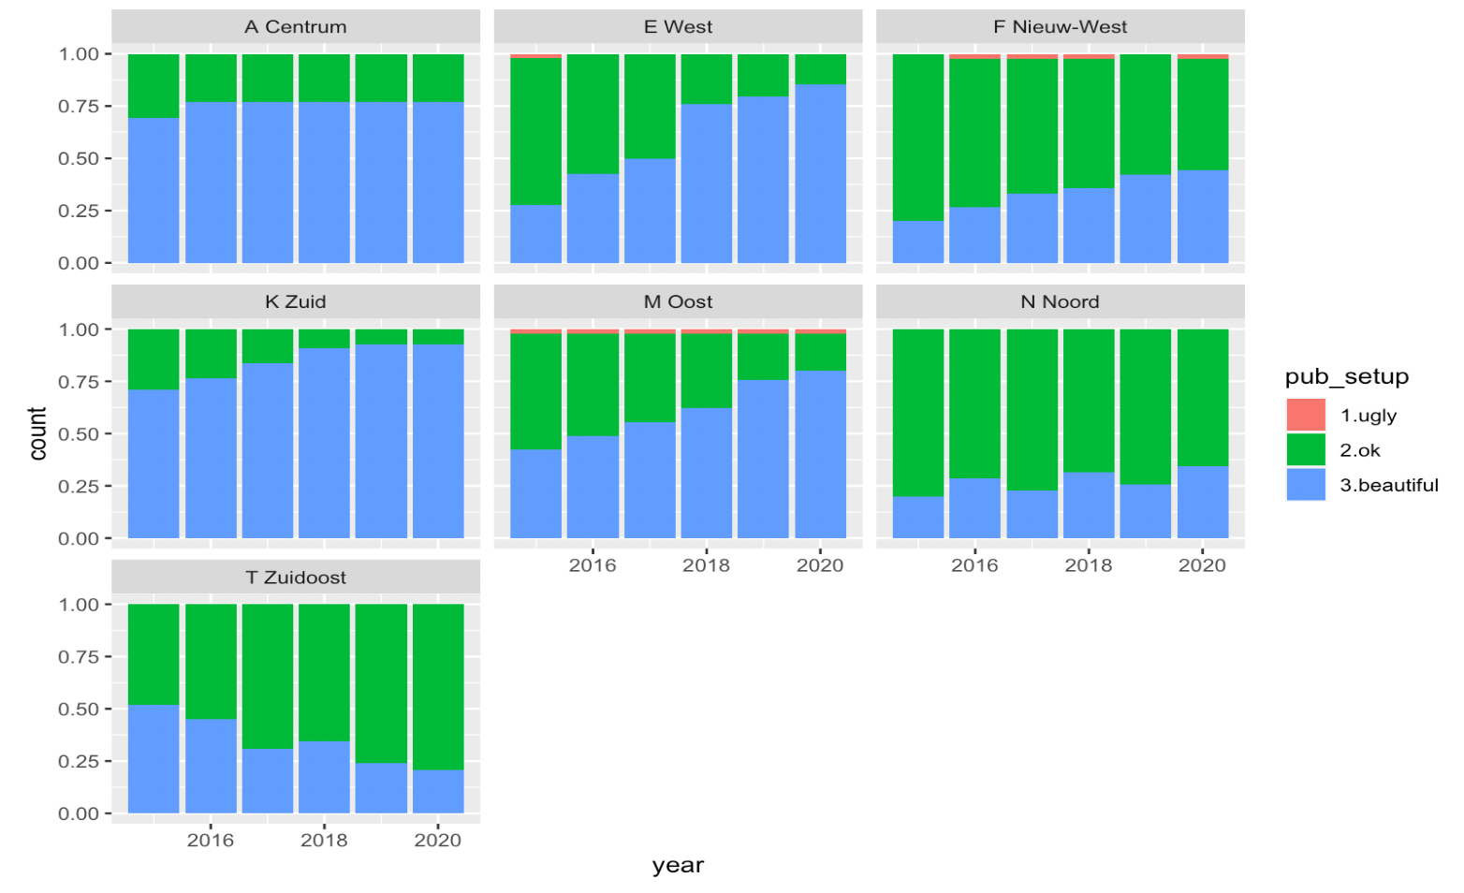
Progress in Aesthetics Local Environment
Most neighborhoods are showing improving perceived aesthetics local environment.
Only Zuidoost is deteriorating.
Notes:
In the next section we will take a closer look at the results of Nieuw-West and Zuidoost. Those are the two poor districts that showed interesting results.

Slide 12
Analysis

Slide 13
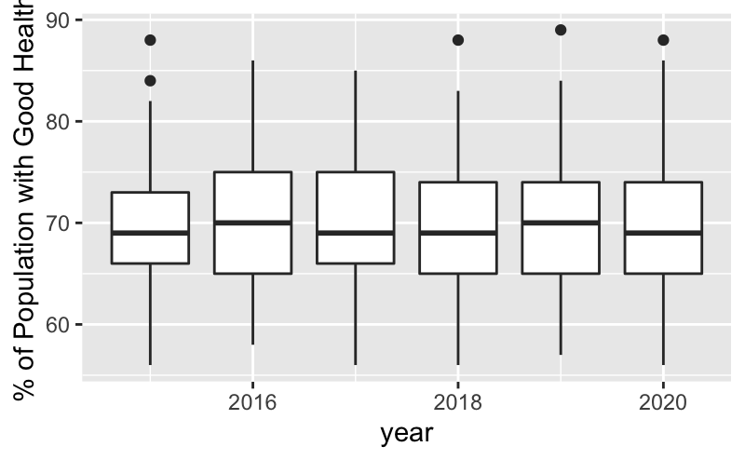
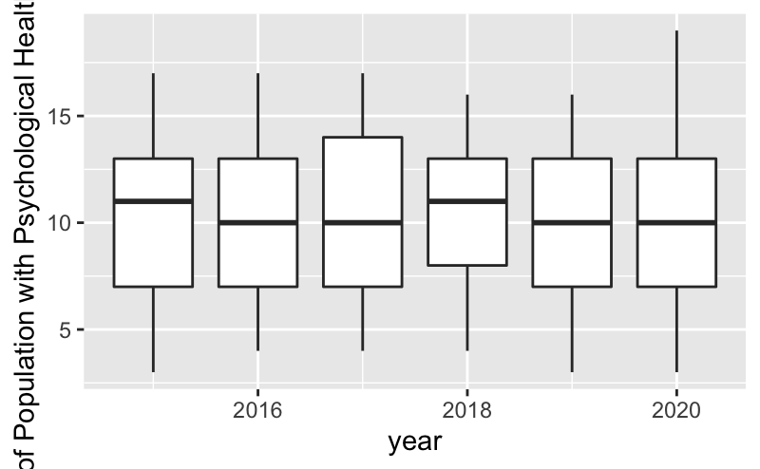
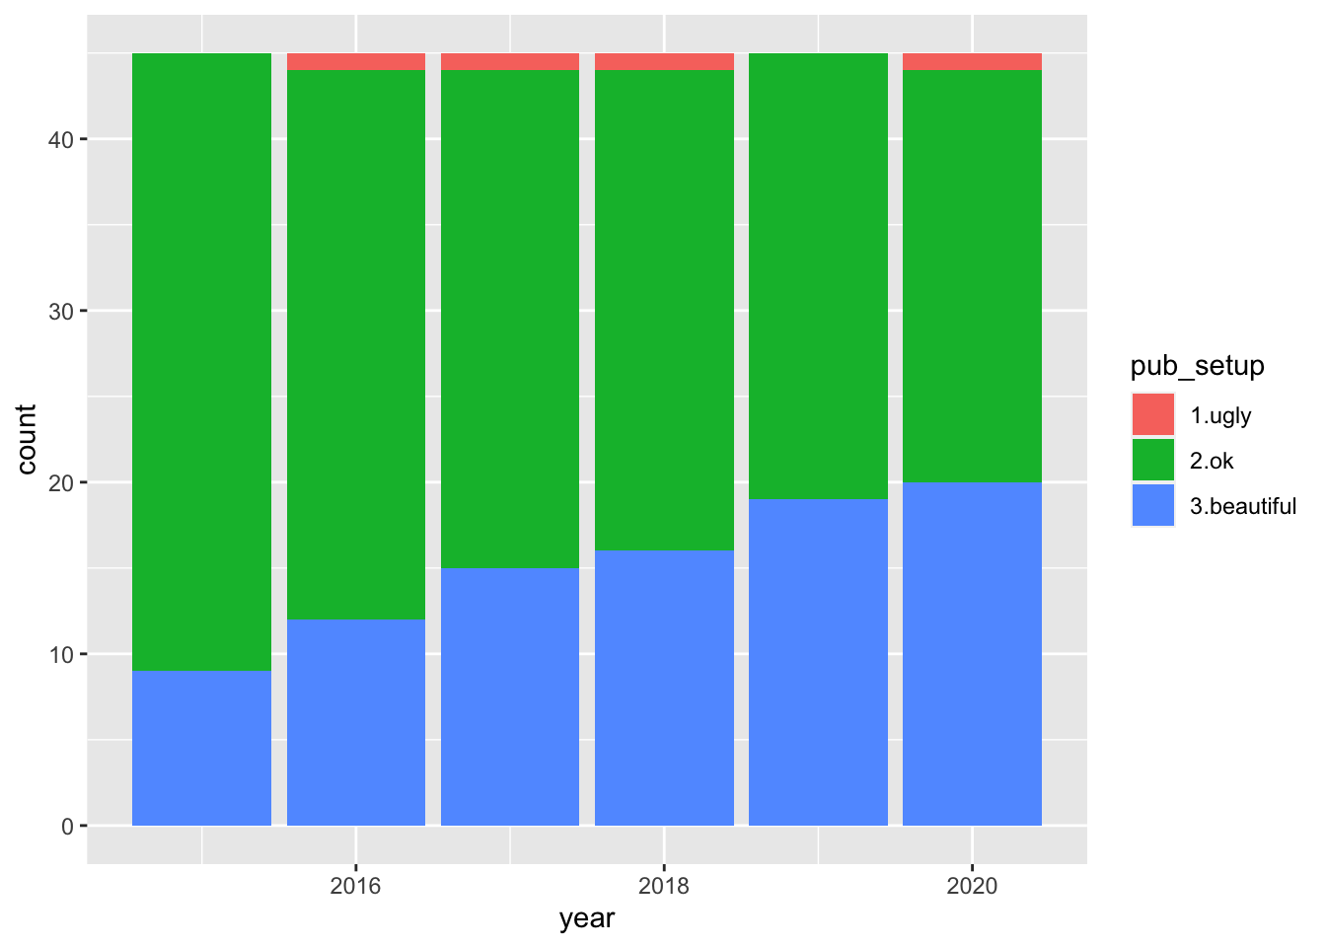
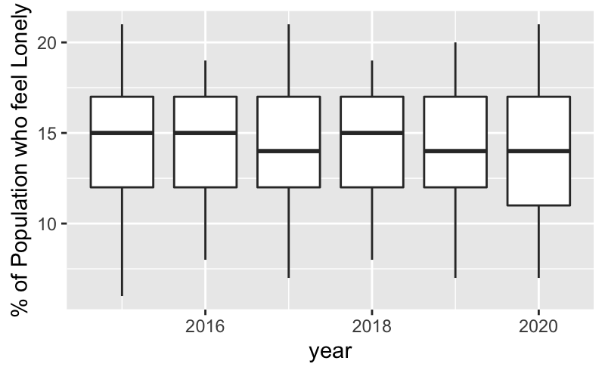
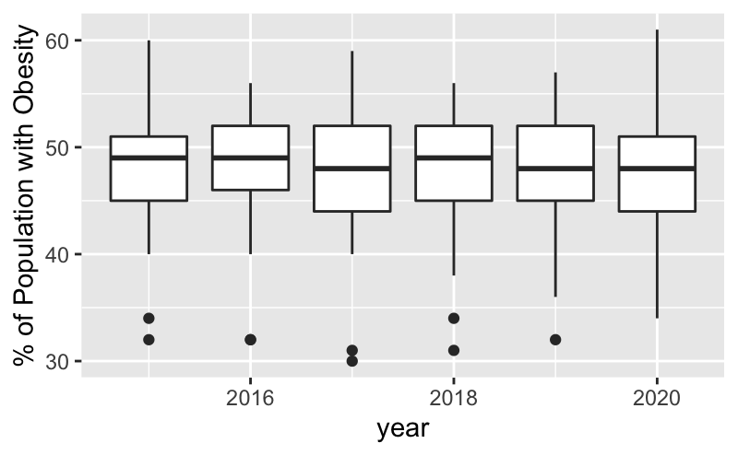
Nieuw-West District
Improving Environment

Slide 14
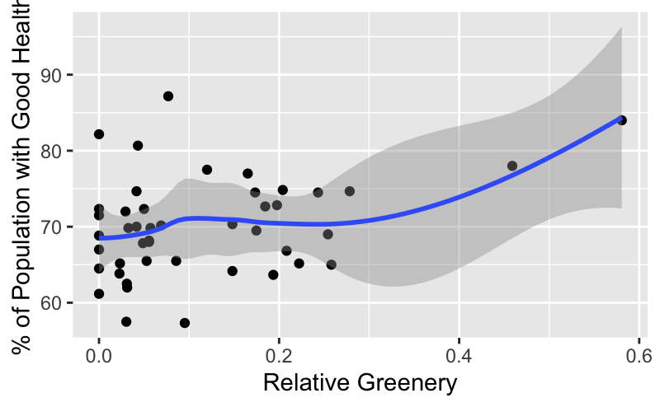
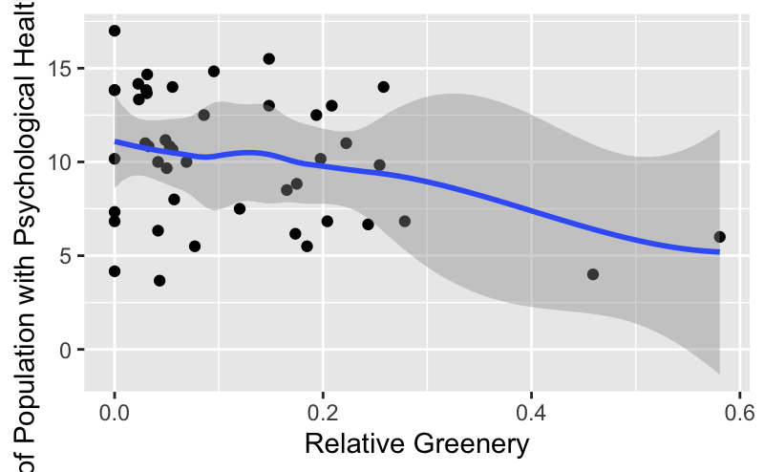
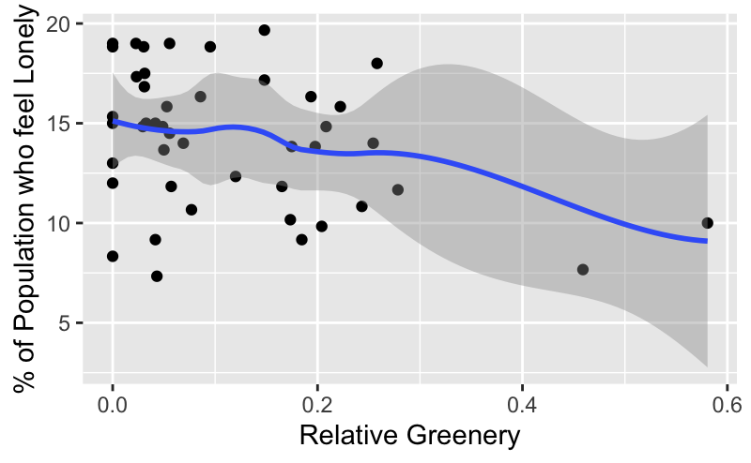
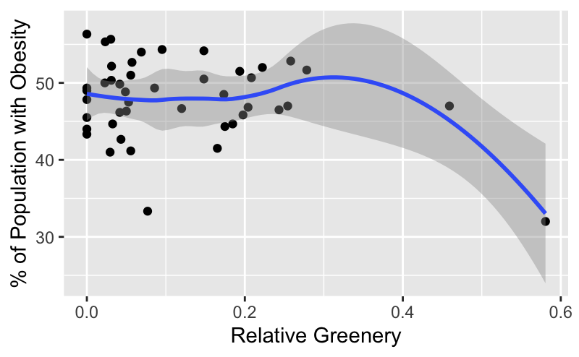
Nieuw-West District
Data contradicts earlier results from district averages
More greenery leads to better perceived health
More greenery leads to less psychological health issues, loneliness and obesity

Slide 15
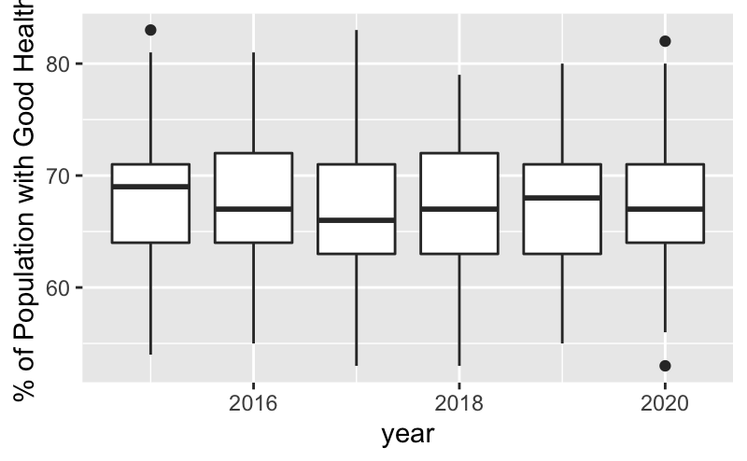
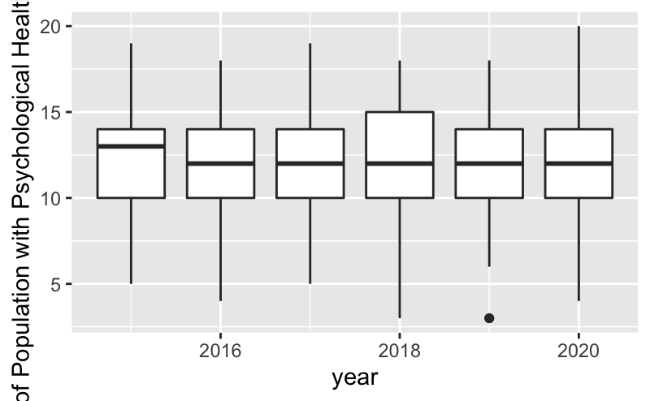
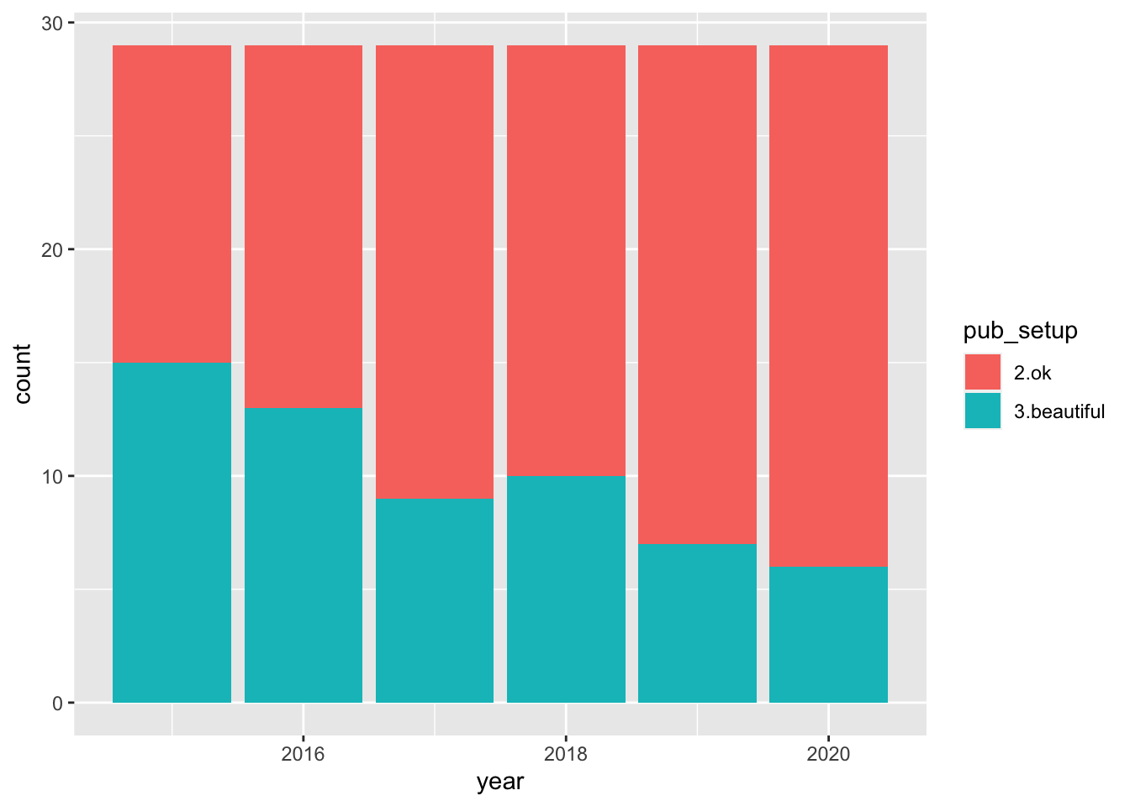
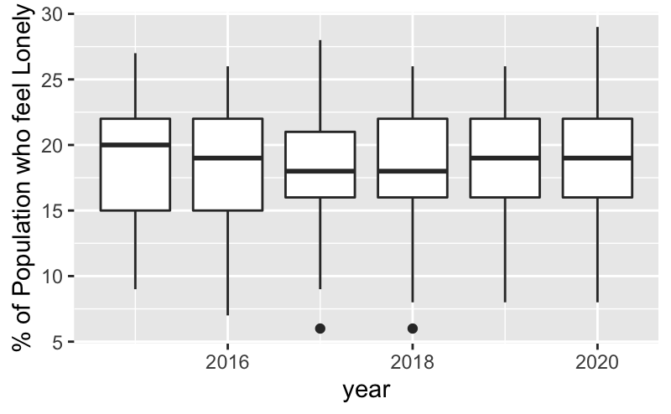
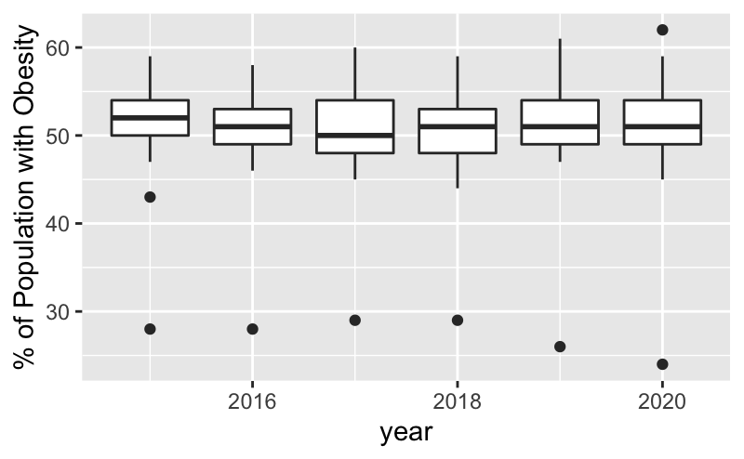
Zuidoost District
Deteriorating Environment

Slide 16
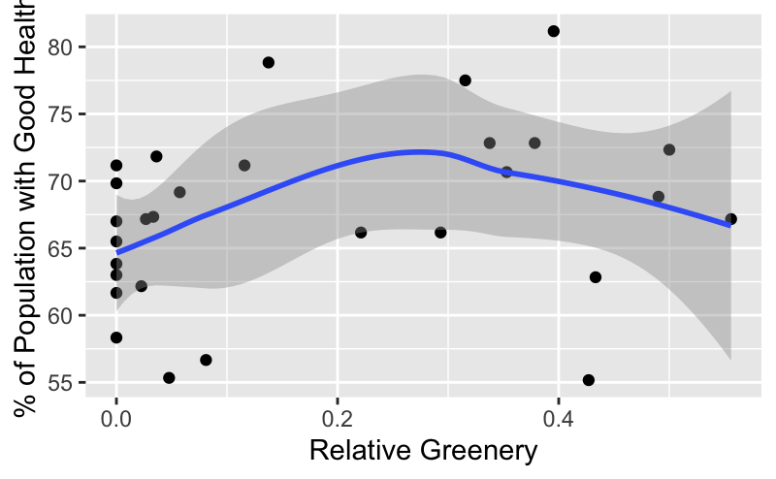
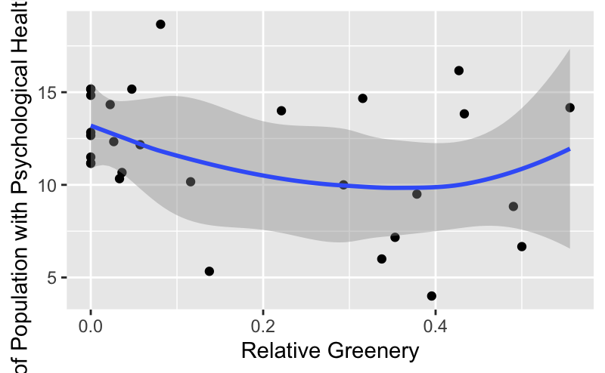
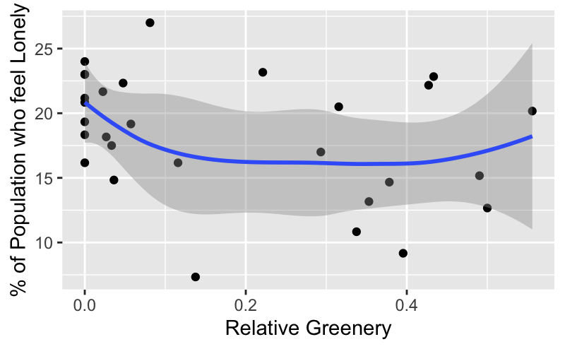
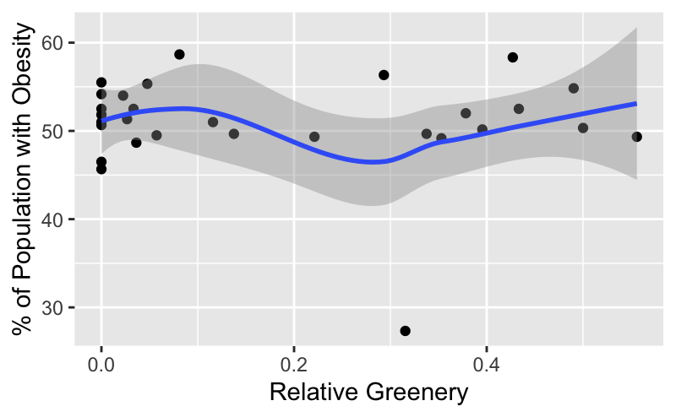
Zuidoost District
Again, a contradiction...
Overall perceived health is more or less stable with greenery
Same goes for psychological health issues, loneliness and obesity

Slide 17
Third Variables
Wealth
More wealth gives better access to health care, healthy food, etc.
Social Facilities
People can practice sports here and engage in other social activities.
Age
Often, people tend to get more health issues as they grow older.

Slide 18
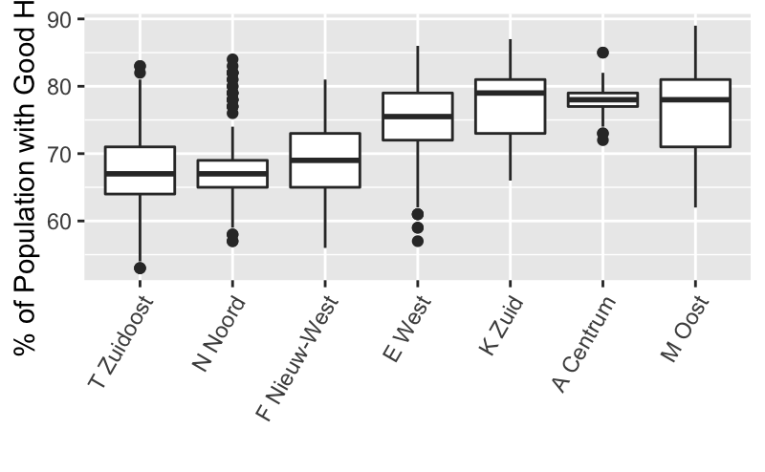
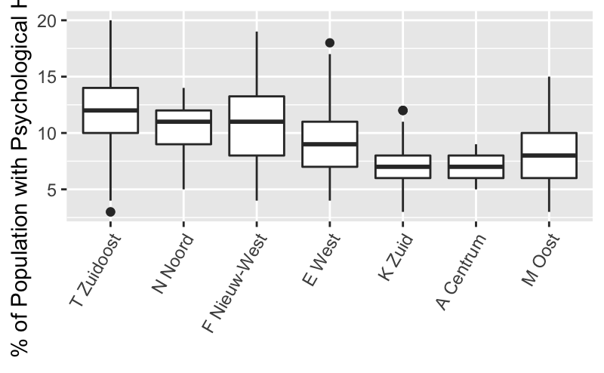
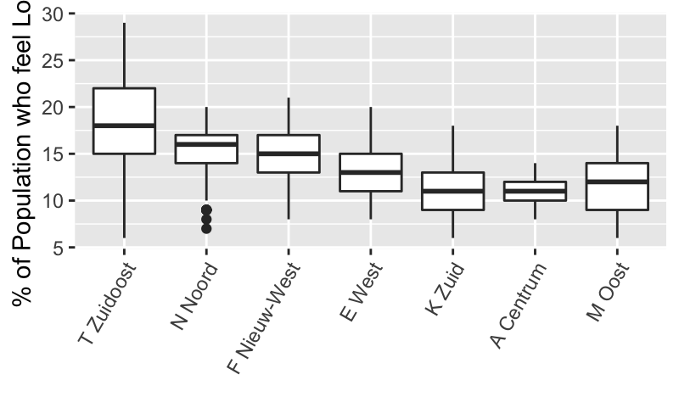
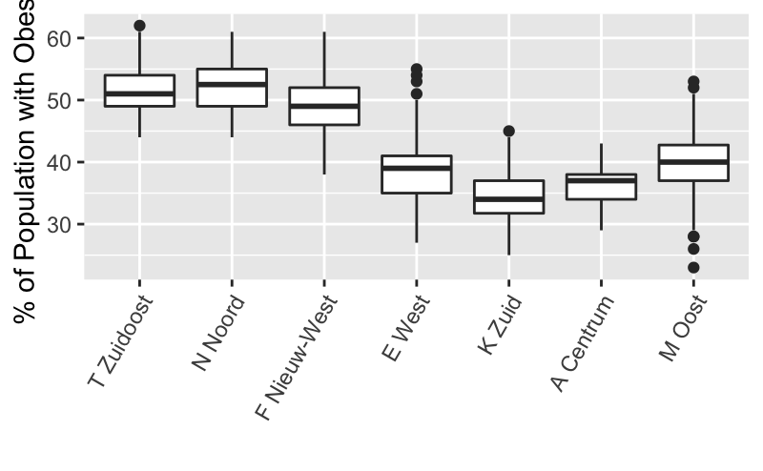
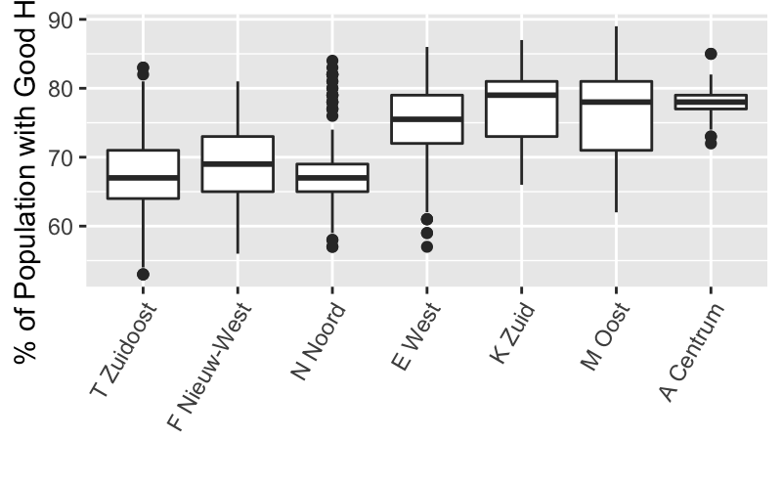
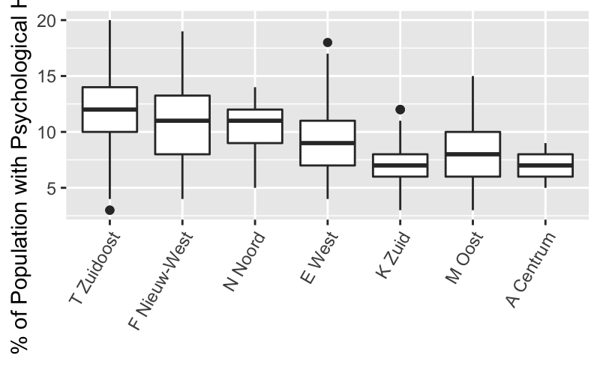
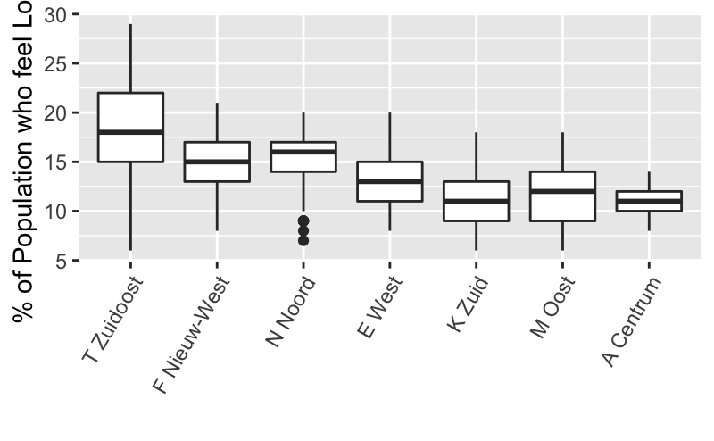
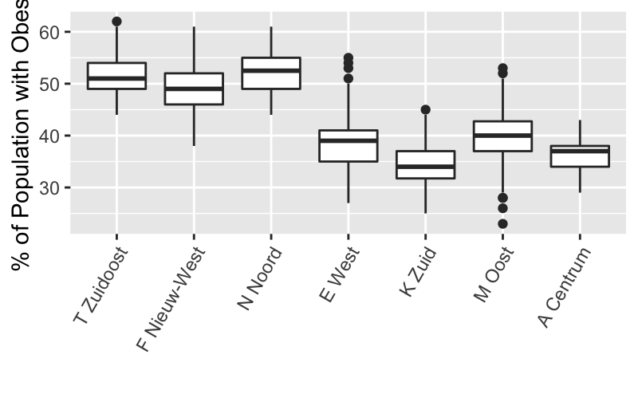
Health & Wealth

Slide 19
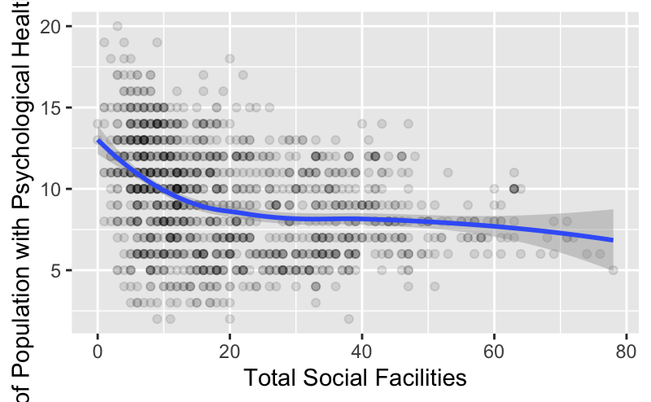
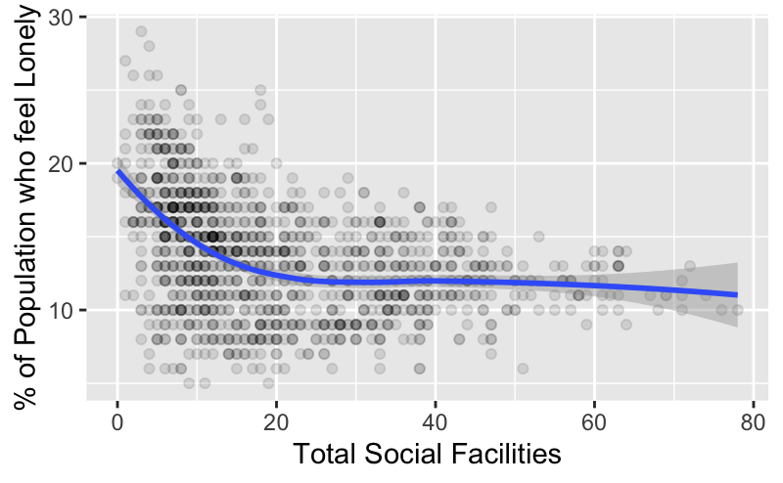
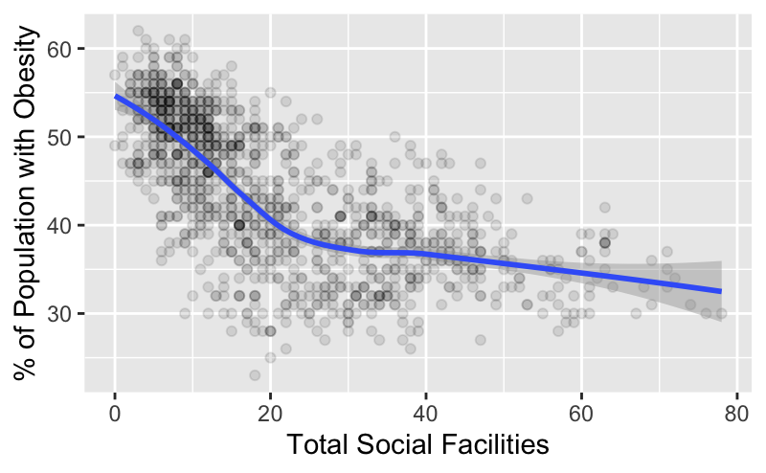
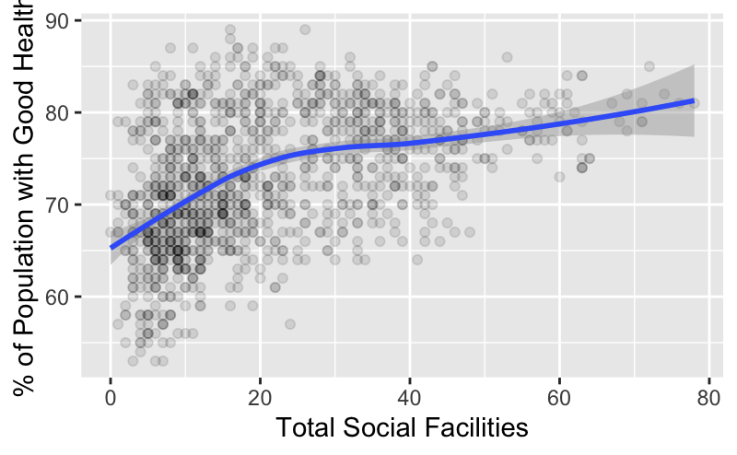
Health & Social Facilities
Total Facilities =
Sports Facilities + Social Facilities
Notes:
Have to be careful here with the fact that people might travel from one district to another to use facilities…

Slide 20
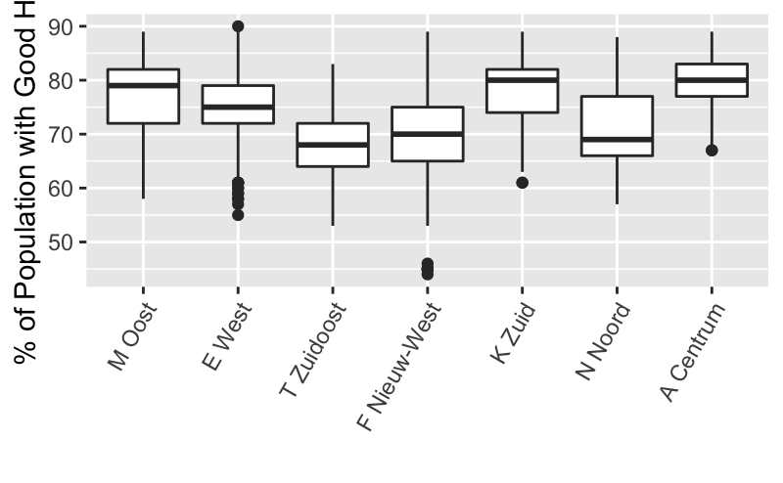
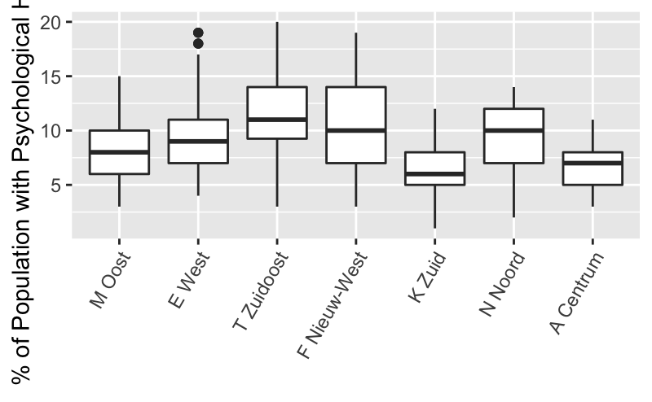
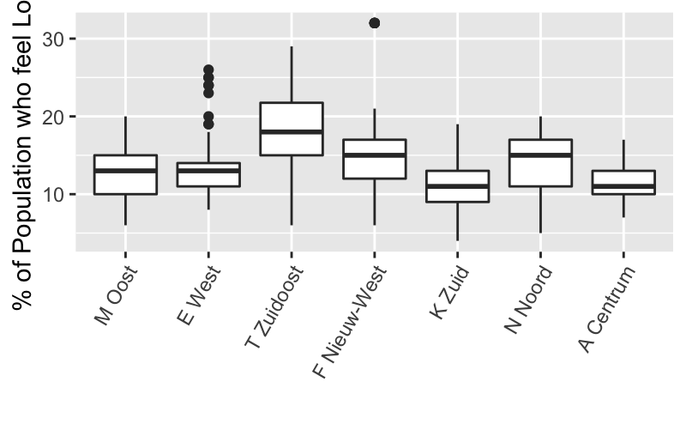
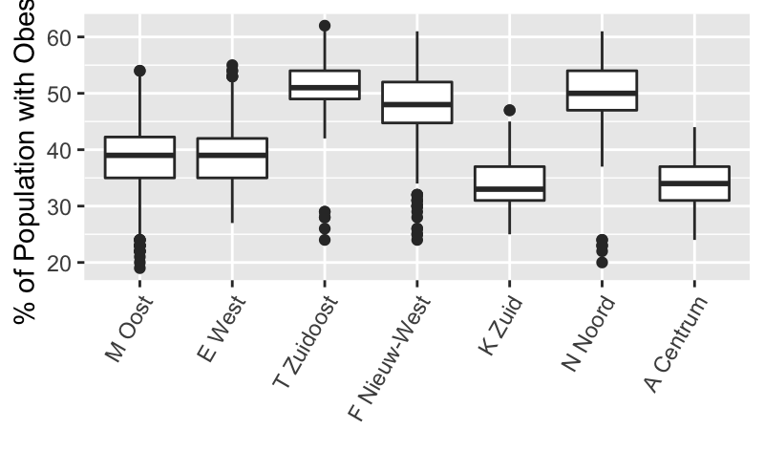
Health & Age
% of Population with age above 60

Slide 21
Interpretation

Slide 22
Underlaying Reasons
Health and Well-being
Perceived Quality of Public Spaces
Amount of Greenery in Public Spaces
Income, Access to Facilities
Population Characteristics
Across the data there are several underlaying factors that influence the results of the analysis.
Notes:
More beautiful greenery tends to lead to more beautiful perceived aesthetics of the local environment.
Amount of greenery per district does not drive health levels but generally spaces are perceived to be more beautiful if the quality of greenery is high.
In richer districts health is at higher levels→ Do richer districts have more facilities?

Slide 23
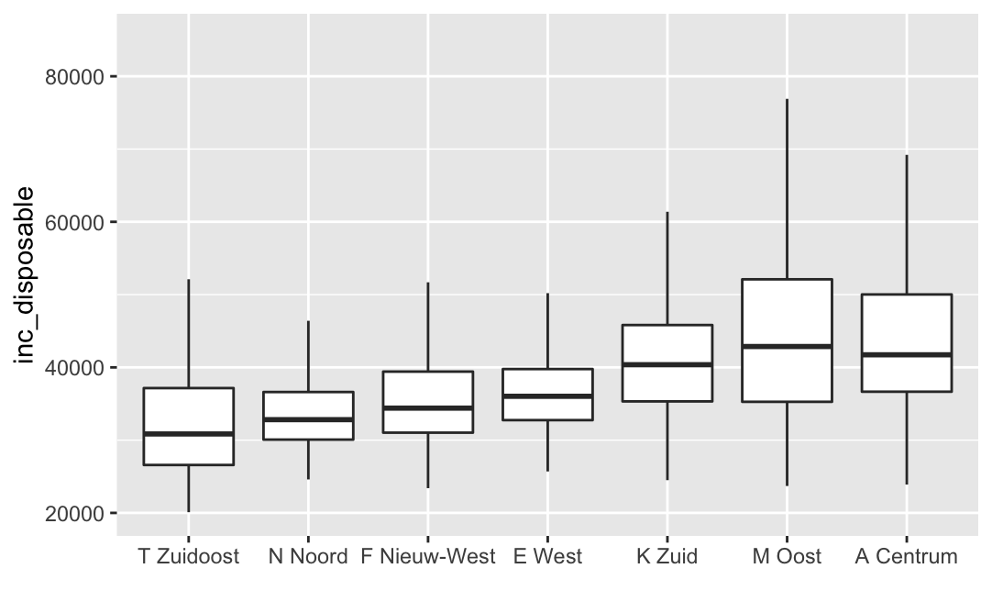
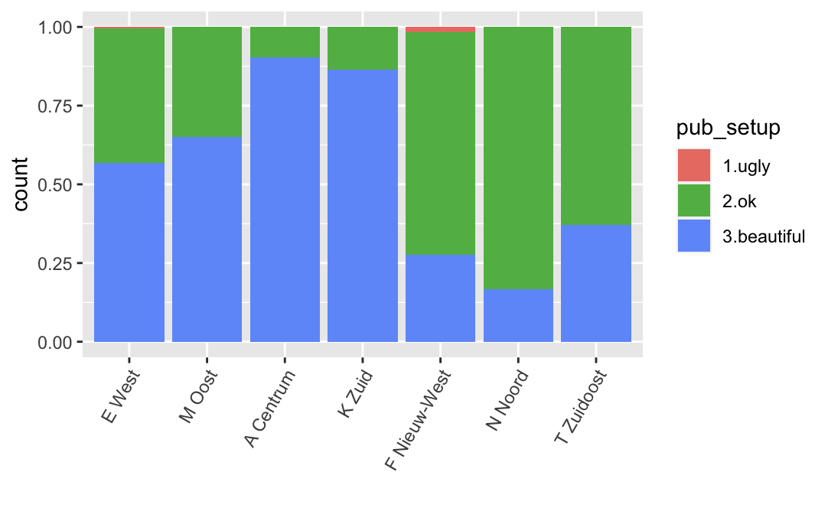
The Important Factor
Notes:
Income is the driving factor for health levels together with the perceived quality of the living environment (especially for values such as psychological health, loneliness and obesity).
Centrum and Zuid are the two richest districts, with relatively high amounts of greenery and are perceived to have the most beautiful living environments.

Slide 24
Implications

Slide 25
Connections Between the Population’s Health, Greenery and Living Environment Aesthetics of Amsterdam
Greenery is a contributing variable to the overall public space aesthetics, but its amount is not a prerequisite for an area being called beautiful, it is its quality. There could be other factors (such as architecture) that contribute to the perceived quality of the living environment setup.
The perceived aesthetic of the living environment is especially connected to variables such as loneliness and psychological health.

Slide 26
Orientation for Policy Development
In poor districts where health is poor, but amount of greenery is high it might be beneficial to at least increase the quality of that greenery. This might have an impact on the perceived quality of the living environment and therefore positively influence mental health.
Focus on providing higher quality education and job opportunities to increase health and well-being in the poorest districts.
Better quality greenery
Better perception of the living environment
Mental Health
Better education
Higher employment
Health

Slide 27
Limitations
Is it that the population who is depressed (poor mental health) tends to assess their surroundings as poor because they are ill or is it really that the environment has the playing role in this?
Greenery is a contributing variable to the overall public space aesthetics, but its amount is not a prerequisite for an area being called beautiful (it is its quality) nor is it directly contributing to health.
Private green areas are not included in the calculations.
Travel patterns are an important factor that might affect the reliability of the study as people cross districts to reach various facilities, parks, etc.
Notes:
Have to be careful here with the fact that people might travel from one district to another to use facilities… Are there more facilities in the rich districts

